Slide 1


AlgoViz:
Real-Time Algorithm Visualization and Learning
N Rushi – U16VB22SO120
GUIDE JINENEDRA JAIN Lecture
DEPARTMENT OF COMPUTER SCIENCE VEERASHAIVA COLLEGE BALLARI-583101
VIJAYANAGARA SRI KRISHNADEVARAYA UNIVERSITY

Slide 2
PRESENTATION OUTLINE
Introduction
Project mission
Hardware & Software Requirements
System Design
ER Diagram (Architecture)
UI Design
Conclusion

Slide 3
INTRODUCTION
AlgoViz :
Real-Time Algorithm Visualization and Learning
AlgoViz makes understanding algorithms easier by providing interactive visualizations for sorting algorithms, binary trees, and graphs.
Visualize the execution of algorithms step by step and compare their performance, helping beginners grasp complex concepts more effectively.
The platform offers algorithm comparisons, problem-solving questions, short notes on time complexity, and summary slides to enhance learning..
This makes learning algorithms easier, more interactive, and effective for students and developers

Slide 4
COMPARATIVE ANALYSIS
Compared to traditional learning methods like books and tutorials, AlgoViz provides interactive visualizations that allow users to see algorithms in action, making it easier for beginners to grasp concepts of DSA, while traditional methods are often more theoretical and static. Unlike code-based algorithm learning, where users have to manually track execution.
AlgoViz offers visual representations and real-time feedback, enhancing understanding. Additionally, AlgoViz stands out from other algorithm visualization tools by offering a broader range of algorithms, including sorting, binary trees, and graph algorithms, along with time complexity analysis and algorithm comparisons, all in a user-friendly interface that simplifies the learning process.

Slide 5
PROJECT MISSION
The main goal of this platform is to create an interactive and complete environment for learning algorithms.
Visualize Algorithm Execution: See algorithm execution in real-time to understand how data is processed
Understand Algorithm Performance: Learn about the performance and efficiency of different algorithms through visualizations and comparisons Compare multiple sorting algorithms side by side.
Compare Sorting Algorithms: Compare multiple sorting algorithms side by side to analyze their differences in behavior and efficiency.
Practice Problem Solving: Reinforce learning by solving problem-solving questions related to algorithms.
Revise with Summary Slides: Quickly revise key concepts with brief and informative summary slides.

Slide 6
IMPACT & BENEFITS
Makes DSA concepts learning easy through visual understanding .
Enhances problem solving skills with interactive practice.
Solving real-world problems helps students build skills and get better job opportunities in tech
Helps compare and analyse different algorithms effectively.
Simplifies complex topics like graphs and trees.
Provides a mobile-friendly platform accessible anytime.
Improves student engagement through quizzes and notes.

Slide 7
HARDWARE REQUIREMENTS
1.Processor: Minimum 1.6 GHz (Dual Core or Higher)
Ensures smooth execution of JavaScript animations and sorting visualizations.
2. RAM: At least 4 GB (8 GB Recommended)
Allows multiple algorithms and visualizations to run efficiently without lag.
3. Storage: Minimum 100 MB Free Space
Required for storing project files, JavaScript libraries, and caching browser data.
4. Graphics Support: Basic Integrated GPU
Enhances smooth rendering of animations and transitions for better user experience.

Slide 8
SOFTWARE REQUIREMENTS
Frontend Technologies:
HTML, CSS ,JavaScript ,Bootstrap (for responsive design and UI components)
Libraries Used:
DOM manipulation libraries (D3.js (Data-Driven Documents))
Visualization libraries (Vis.js (vis-network), D3.js (Data-Driven Documents)))
Browser Support:
Compatible with all modern browsers (Chrome, Firefox, Edge)
Development Tools:
Code Editor: VS Code
Version Control: GitHub (for deployment)

Slide 9
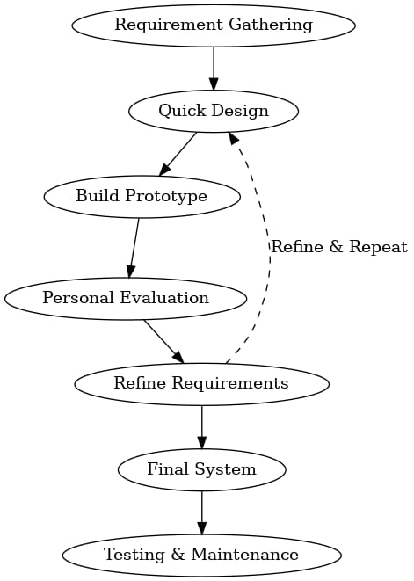
SYSTEM DESIGN
Software Development Life Cycle :
Prototype Model
The project was developed feature-by-feature (like:- sorting first, then tree, graph, etc.).
Each module was tested, improved and then moved forward to the next.
The interface and visual features were modified after seeing the output.
personal review was used to refine and expand the system.
Matches the iterative and personal feedback-driven approach of the Prototype Model.

Slide 10
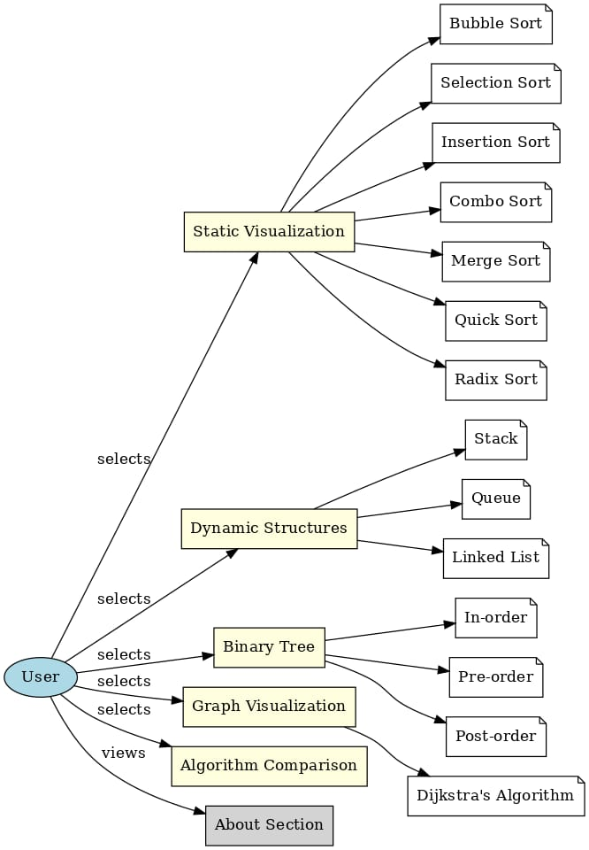
ER Diagram

Slide 11
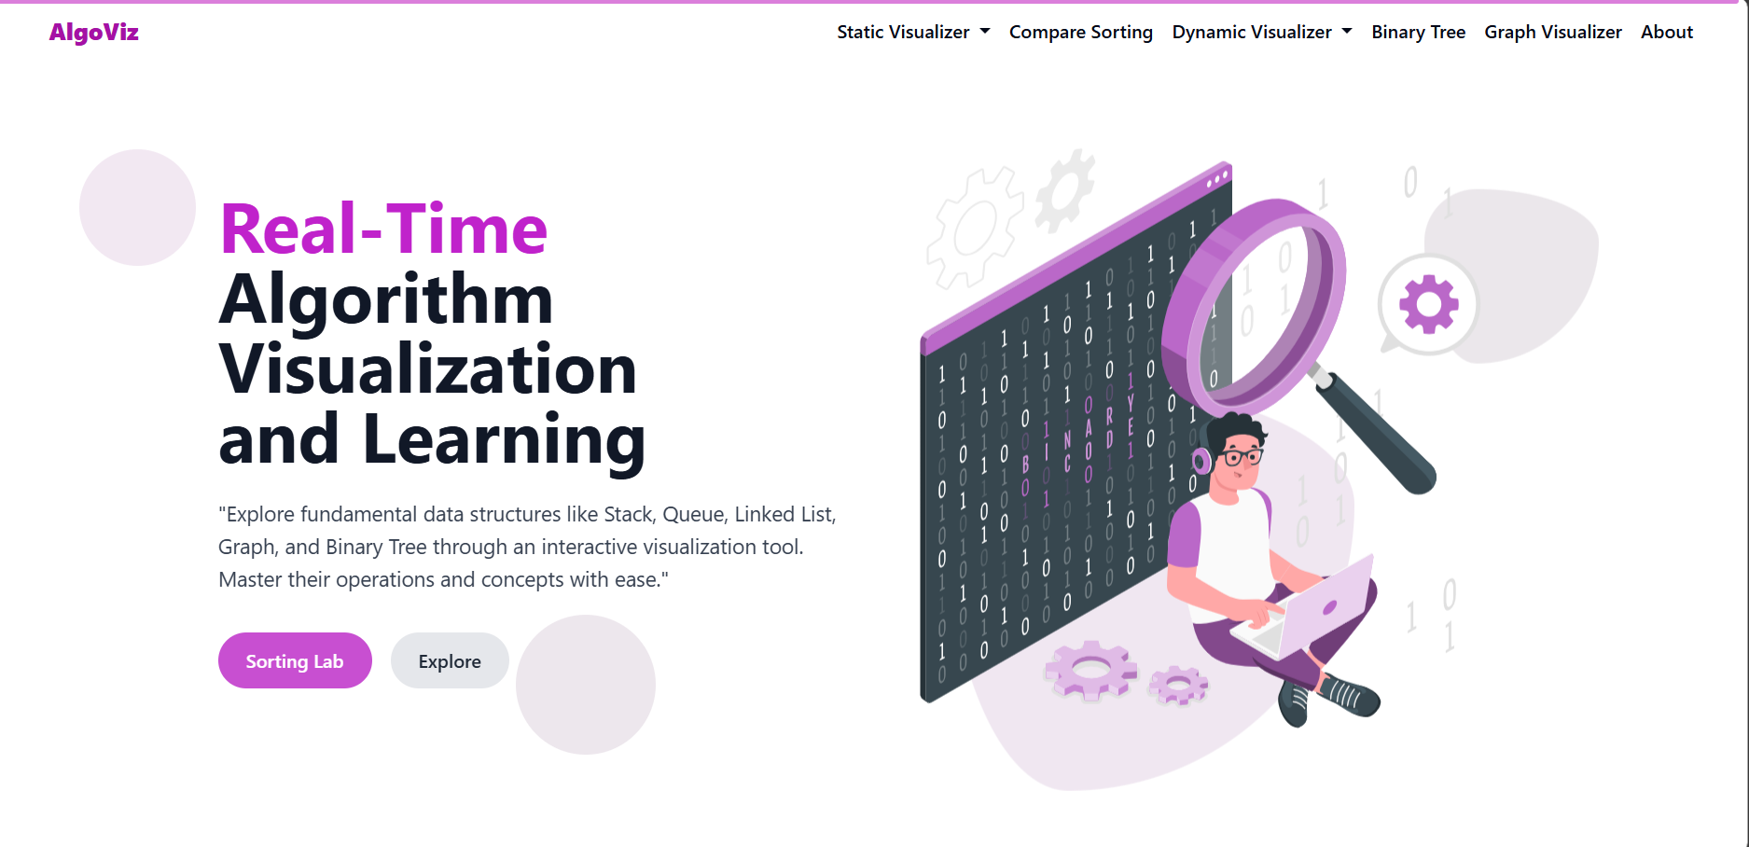
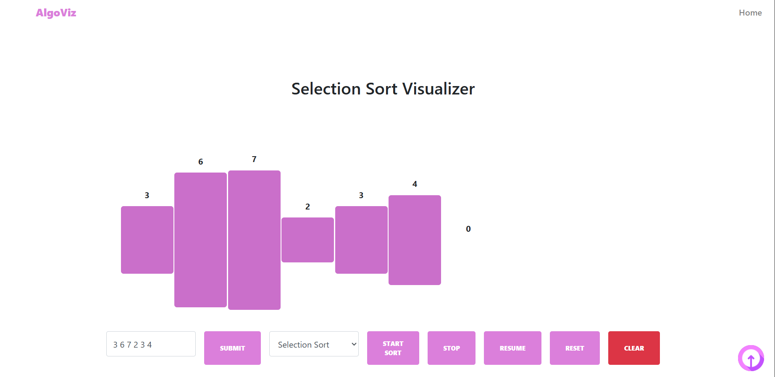
UI DESIGN
HOME PAGE
VISUALIZATION PAGE

Slide 12
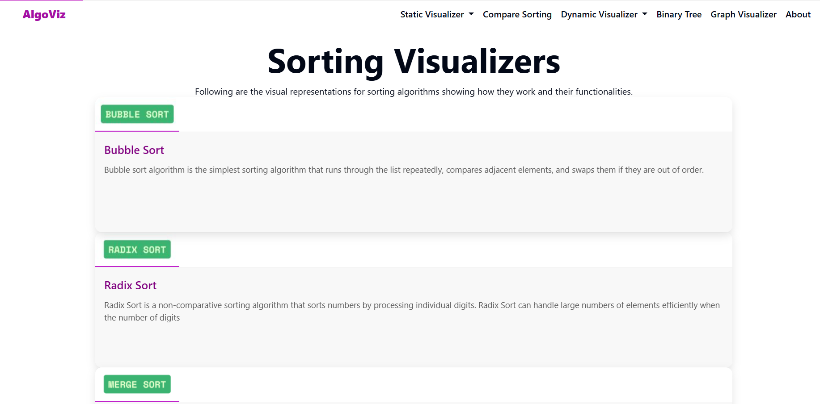
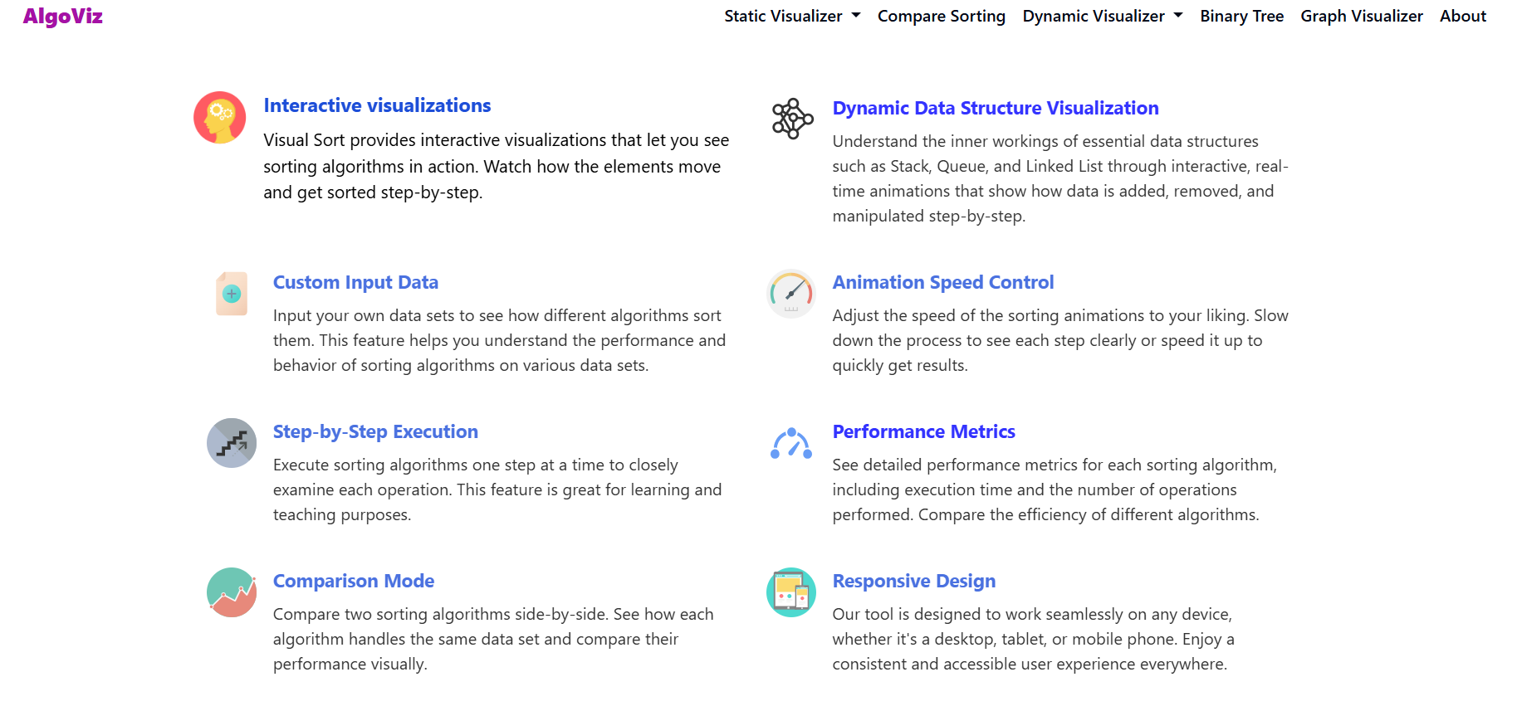
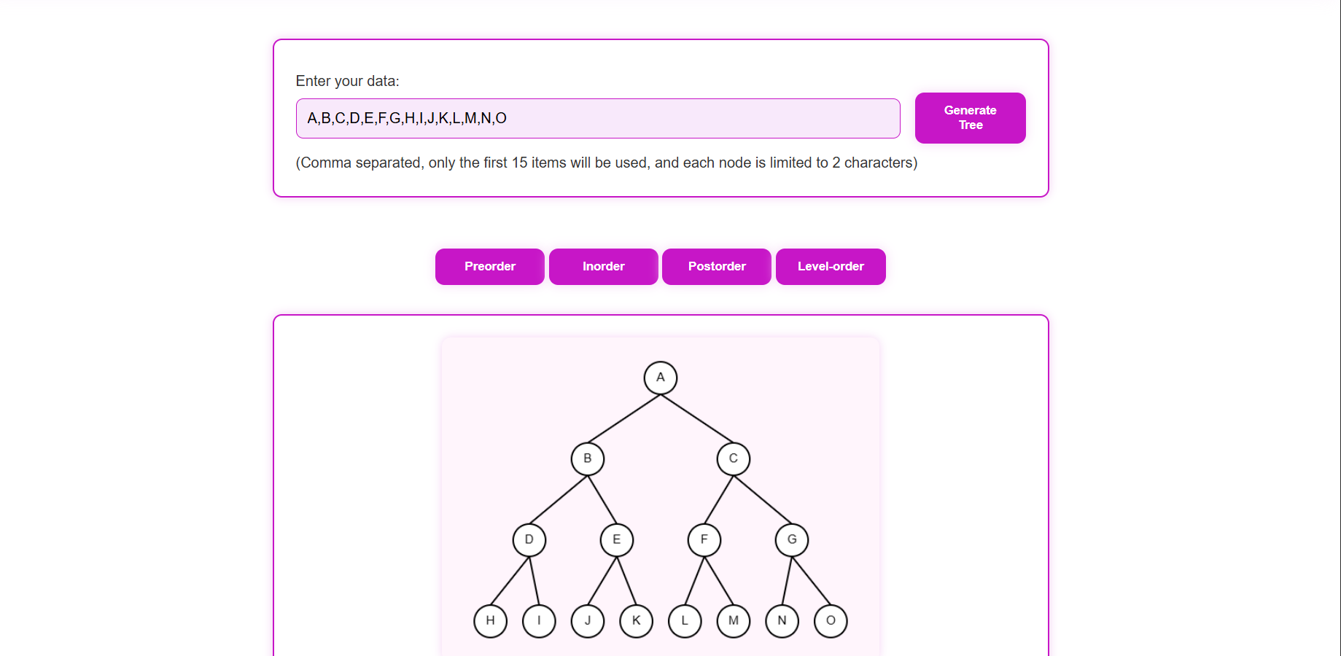
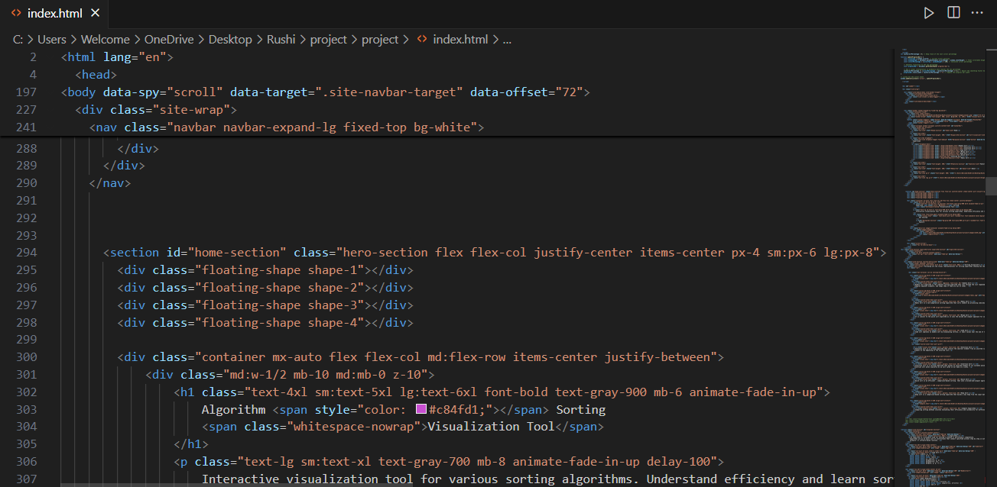
SELECTION VIEW
FEATURES VIEW
BINARY TREE VISUALIZATION PAGE
CODING PART

Slide 13
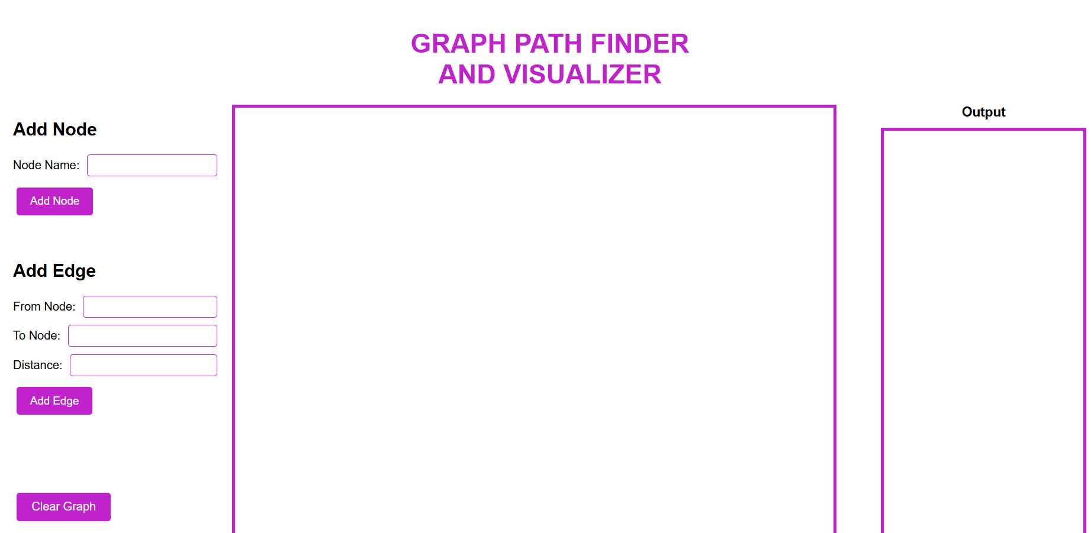
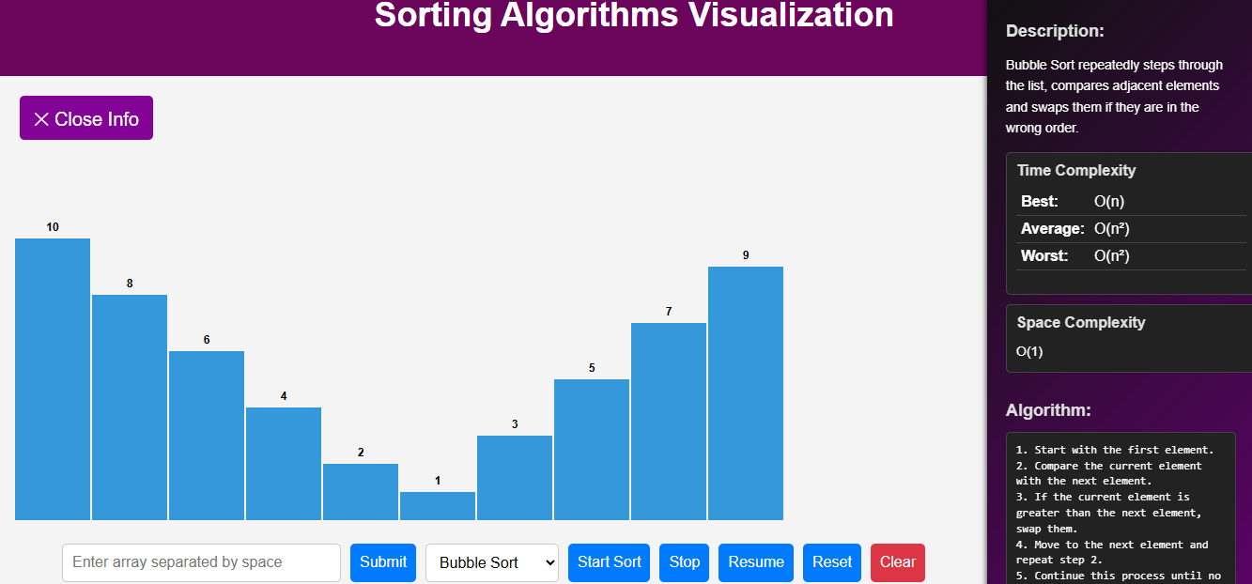
GRAPH VISUALIZATION PAGE
SMALL NOTES WITH VISUALIZATION PAGE

Slide 14
CONCLUSION
This project offers an interactive way to understand DSA concepts like sorting, binary trees, graphs, static ,queue ,linked list using visualizations. With added features like practice problems, notes, and comparisons, it makes learning more engaging and effective. Its mobile-friendly design makes it easy to use for students and developers.
What makes “AlgoViz: Real-Time Algorithm Visualization and Learning” stand out is its practical and student-friendly approach. It combines learning tools like slides, visual guides, and real-time interactions in one place, helping users grasp complex topics more easily.

Slide 15
Future Enhancements
Add quizzes to test user understanding
Provide certification for completed modules
Integrate an AI assistant for guidance and support
Enable downloading of algorithm visualizations
Implement automatic code generation for algorithms
Add all DSA problems

Slide 16

thankyou

